Slide 1


Photonic 3D bioprinting of human tissue models

Slide 2
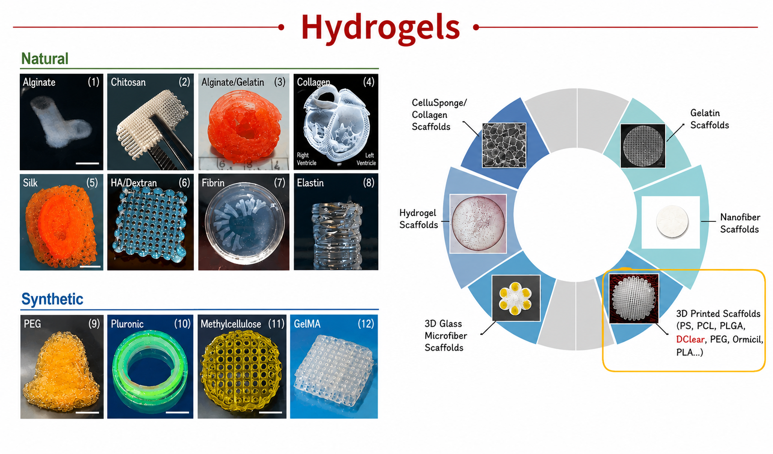
Materials for 3D Bio-printing

Slide 3
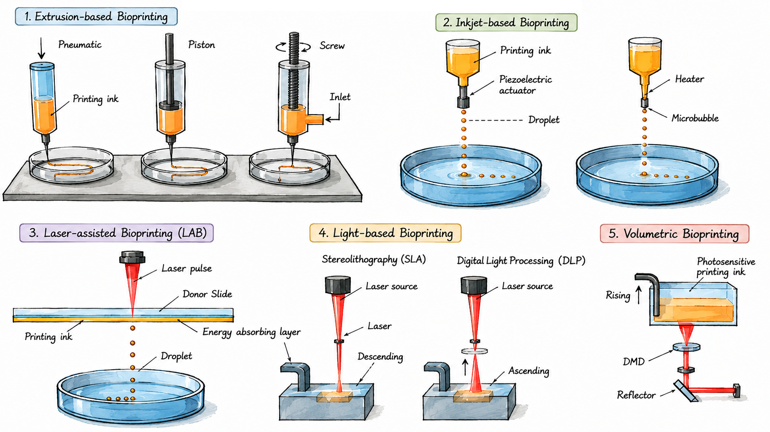
3D Bioprinting Techniques

Slide 4
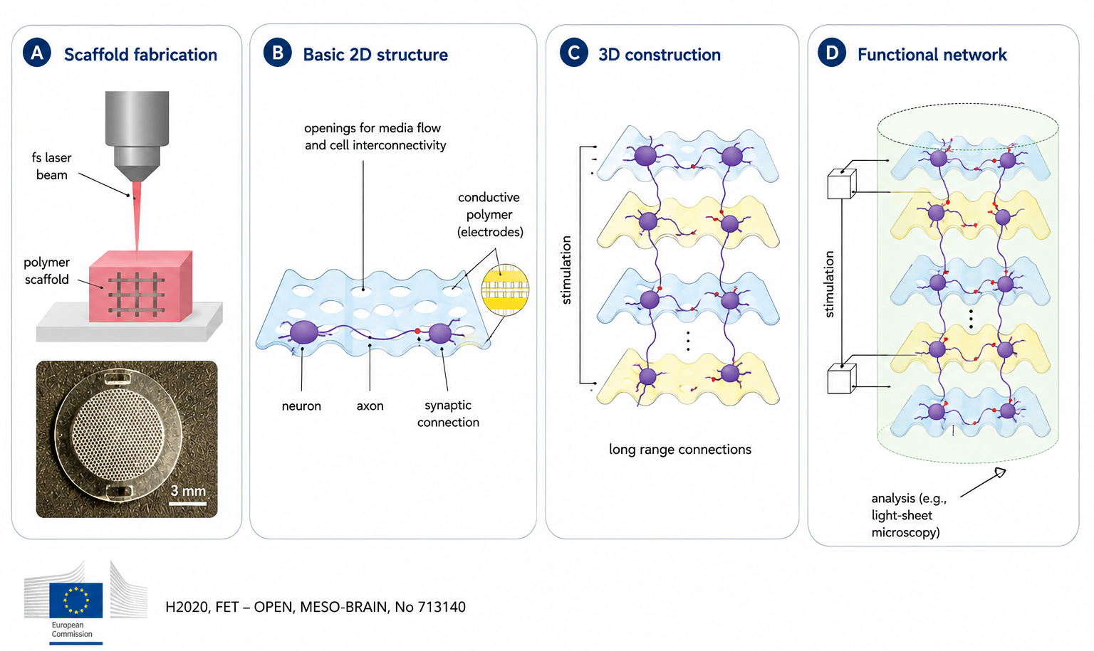
3D Neuronal Network on the 3D Scaffolds

Slide 5
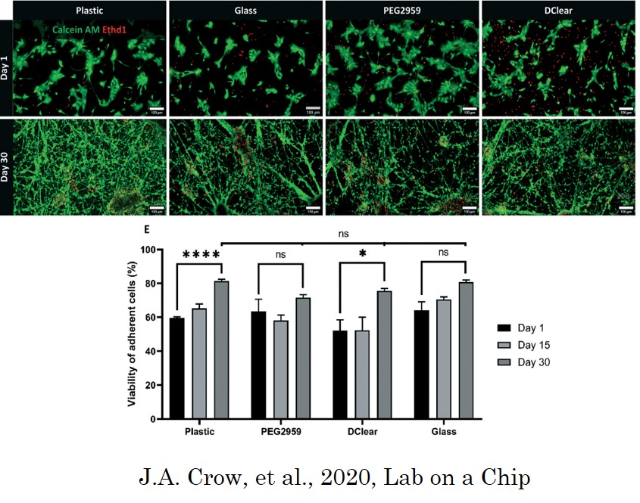
Research update

Slide 6
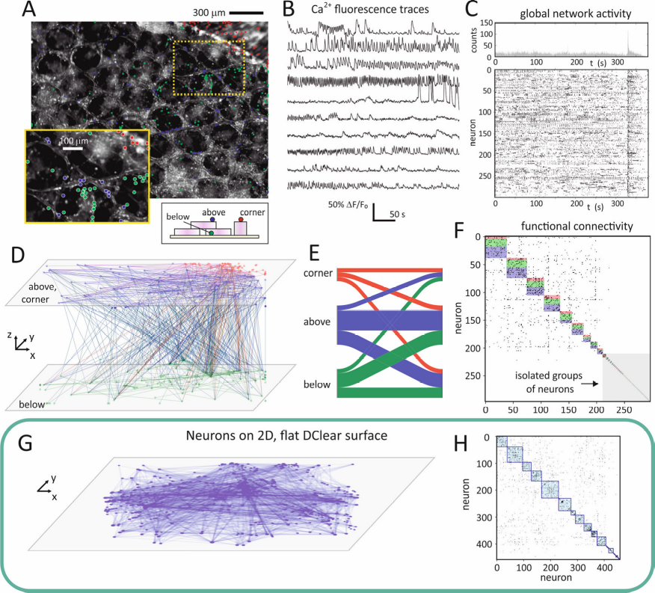
Human Cortical Projection Neurons on the 3D Scaffolds
3D scaffold
effective connectivity
Flat DClear
A. Koroleva et al., 2021, ACS Appl Mater. Interfaces 13, 7839-53

Slide 7
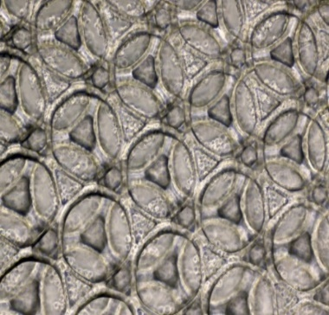
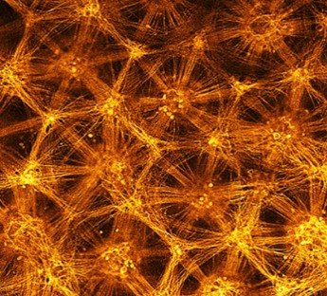
hiPSC-derived Neurons Network: Motor-muscle model
Day 1
Day 12
Curtesy of Dr S. Prime, AXOL Biosciences Ltd, Cambridge

Slide 8
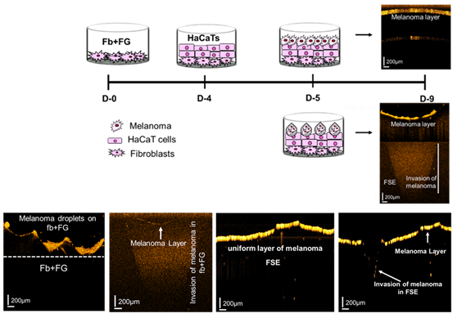
Morphology and metabolism of 3D FSE
A. Arooj, et al. 2026 in Prep.

