Slide 1
GLIOLIGHT – VINS modeling attempts
From singlet-oxygen signals to oxygen dynamics, light transport and PDT/DLT modelling
Modelling-status talk:
what has been tried,
what physics we clarified,
what must still be constrained before quantitative PDT/DLT prediction.
Aleksandra Maluckov
1

Slide 2
Main modelling tasks
Fitting provides the target.
Modelling asks which physical state could have produced it.
We need a forward model that mimics the measurement process.
1 Reproduce S(t)
2 Oxygen dynamics
3 Light → chemistry
4 Synthesis
Generate the measured photon-counting curve from sample physics, not only from a fit function.
Model oxygen supply, respiration and light-induced consumption in monolayers and spheroids.
Connect the local optical field to PpIX excitation or to an effective PS-free ROS source.
Use a virtual experiment to generate a measured-like curve.
2

Slide 3
What is common and what is different between PDT and DLT?
PDT: 5-ALA / PpIX-assisted branch
DLT / PS-free branch
• 5-ALA → PpIX inside cells
• light excites PpIX → triplet PS
• triplet PS transfers energy to ground-state O₂
• source depends on I(r), PpIX(r), O₂(r,T)
• bleaching can matter
• no added PpIX / photosensitizer branch
• light is mapped to an effective ROS / ¹O₂-like source
• optical propagation can be simulated
• conversion efficiency is not independently fixed
• this is the open physical part
Key message: the general modelling architecture can be similar, while the chemistry connecting light to the source term is different.
PDT is the reference; DLT is the branch requiring additional physical calibration.
3

Slide 4
1. First modelling attempts
This is the map of what has actually been tried and what each part clarified.
Monolayer / thin samples
Spheroids
Virtual experiment
Mouse / in vivo next
radial O₂ diffusion;
respiration and PDT sink;
local O₂ changes kinetics
freeze slow profiles;
calculate fast kinetics;
generate synthetic S(t)
first measurements started;
tissue optics and perfusion;
model to be formulated
processed 1270-nm curves;
gas–liquid O₂ supply;
simpler first optical path
The purpose of these simpler models is to understand which physical quantitates really control the observable.
4

Slide 5
2. Oxygen dynamics module
Slow sample state: oxygen supply competes with respiration and light-induced consumption.
Main state variable*: Cₒ₂(r,T) = local molecular oxygen concentration on seconds/minutes time scale (T)
∂Cₒ₂/∂T = diffusion − respiration − light-induced oxygen sink
oxygen enters and
spreads through the sample
cells consume oxygen biologically
PDT/ROS chemistry can consume oxygen
Monolayer → oxygen supply from the medium is presented by an interface flux
Spheroid → oxygen has to diffuse to the center being continuously consumed
J(O₂) = K_{ᴸ} (C_{sat} − C_{surface})
O₂ gradients and a hypoxic core
K_{L} - mass transfer coefficient at the interface, not the internal diffusion coefficient.
So radius, respiration, external oxygen and illumination all matter before we even start discussing the microsecond luminescence signal.
*State- slow state variables: spatial oxygen and photosensitizer distributions, Cₒ₂(r,T) and C_{PS}(r,T) , cell bleaching state
5

Slide 6
Oxygen depletion and triplet kinetics
Connection between oxygen transport and the measured kinetics.
1. Oxygen depletion estimate in spheroid sample
2. Oxygen is also quenching channel of PpIX triplet
C_{center} ≈ C_{ext} − q R² / (6D)
1 / τ_{T}(r) = 1 / τ_{T,0} + k_{q} C_{O₂}(r)
→
larger R or q → stronger O₂ depletion
larger D → better O₂ replenishment
O₂ ↓ → weaker triplet quenching
→ local τ_{T} increases
to the measured
lifetime
What the detector fits
A spheroid contains many local τ_{T}(r) values. The detector sees the spatially summed emission, so the fitted τ_{T} is an effective value, ${τ_{T}^{}}^{eff}$ , not one microscopic lifetime.
Key message: The first equation tells us whether oxygen depletion is expected; the second tells us how this depletion can appear in the kinetics.
6

Slide 7
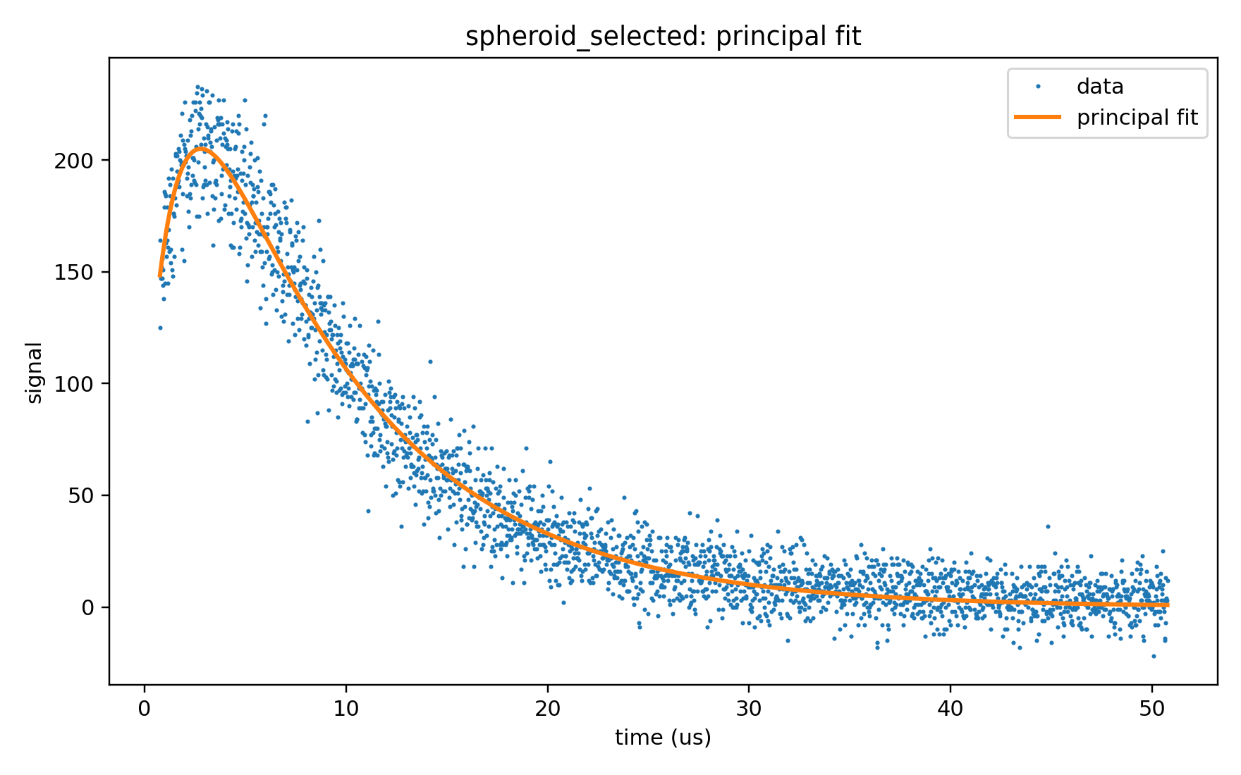


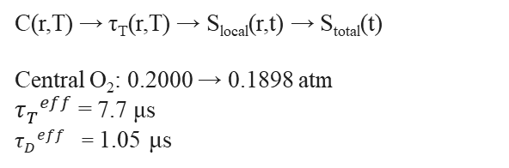
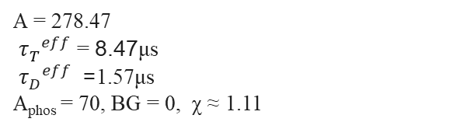
Spheroid example:
Layered spheroid model
Measured curve and fitted response
What was extracted / what the model gave
Outer shells: better oxygen supply
O₂ in
Experimental fit (selected spheroid)
A = 278.47
${τ_{T}^{}}^{eff}$ =8.47 μs
${τ_{D}^{}}^{eff}$= 1.57μs
A_{phos} = 70, BG = 0, χ ≈ 1.11
r
$Signal\left(t\right)=A\left[e^{−t/{τ_{T}^{}}^{eff}}−e^{−t/{τ_{D}^{}}^{eff}}\right]+A_{phos}e^{−t/{τ_{T}^{}}^{eff}}$+BG
Inner shells: lower oxygen
First oxygen-to-signal bridge
C(r,T) → τ_{T}(r,T) → S_{local}(r,t) → S_{total}(t)
Central O₂: 0.2000 → 0.1898 atm
${τ_{T}^{}}^{eff}$= 7.7 μs
${τ_{D}^{}}^{eff}$ = 1.05 μs
Each shell i is assigned a local oxygen level C_{i}(T).
Then a local microsecond signal S_{i}(t) is computed and spatially summed.
$$\frac{∂Ci}{∂T}=D\frac{1}{r^{2}}\frac{∂}{∂r}\left[r^{2}\frac{∂Ci}{∂r}\right]−R_{resp}\left(Ci\right)−R_{PDT}$$
NCH82 spheroid - Blue dots: measured time-resolved 1270-nm signal.
Orange line: fitted phenomenological curve.
Main message: at this stage the trend is meaningful→ lower oxygen gives weaker triplet quenching and therefore a longer effective triplet-related lifetime.
7

Slide 8
3. Optical module: from light transport to the local source term
The optical calculation should provide the absorbed-light field used by the oxygen / ROS model.
Physical starting point: radiative transfer
L(r,ŝ): radiance — light at position r travelling in direction ŝ
S_{opt}: laser/source term injected into the optical problem
μ_{a}, μ_{s}: absorption and scattering coefficients
p(ŝ,ŝ′): scattering phase function
ŝ · ∇L(r,ŝ) = −(μ_{a} + μ_{s})L(r,ŝ)+ μ_{s} ∫ p(ŝ,ŝ′) L(r,ŝ′) dΩ′ + S_{opt}(r,ŝ)
Practical implementation: Monte Carlo photon transport
s = − ln(ξ) / (μ_{a} + μ_{s})
s- sampled free path between photon interactions
Each photon is followed through the real geometry: absorption, scattering, interfaces, beam profile,top / bottom illumination and wavelength-dependent coefficients.
Output of optics
What chemistry needs
Model input
Φ(r) = ∫_{₄π} L(r,ŝ) dΩ
→
Q_{abs}(r) = μ_{a}(r) Φ(r)
→
q_{PDT}(r) or q_{DLT}(r)
fluence rate: local optical power from all directions
absorbed optical power density
source / sink term for the next model
S_{opt} creates the light field; Q_{abs} = μ_{a}Φ is the absorbed field that drives the local PDT/DLT chemistry.
The interface between the optical model and our oxygen-photochemistry model is well defined: a spatial optical field, with known wavelength, geometry and normalization.
8

Slide 9
WHERE PDT and DLT SEPARATE AFTER THE OPTICAL CALCULATIONS
PDT branch — physically clearer
DLT / PS-free branch — open source law
I₆₃₅(r) + C_{PpIX}(r,T) → triplet PS → ¹O₂
I₁₂₆₇(r) → ? → effective ROS / ¹O₂ source
• 5-ALA/PpIX pathway gives a constrained photochemical chain
• local source depends on optical field, PpIX and oxygen
• PDT is the reference branch for testing the model architecture
• no added PpIX / triplet mediator
• optical field can be calculated, but conversion efficiency is not fixed
• the DLT source term must be measured, bounded or calibrated
Downstream from that source term, however, the oxygen and signal modelling steps can be shared.
9

Slide 10
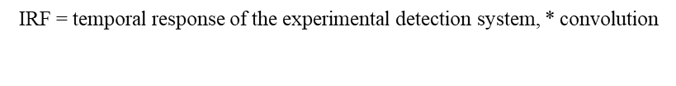
4. Virtual experiment: putting the pieces together
slow time T
optical pulse
microtime t
seconds / minutes
one excitation event
0–80 μs after trigger
1. Slow sample state
2. Freeze + illuminate
3. Fast photophysics and signal
Oxygen, photosensitizer and cells evolve during treatment. This is transport / biology time, not microsecond fitting time.
At one treatment time T*, the slow profiles are frozen.
One optical pulse sees local values in each shell or voxel.
After the pulse, triplet population decays, singlet-oxygen is produced and decays and photons are emitted.
triplet P_{Tᵢ}(t) → singlet Δᵢ(t) →S_{virtual}(t)
∂Cₒ₂/∂T = diffusion − respiration − light sink
Cᵢ = Cₒ₂(rᵢ,T*)
Q_{abs}(r) from optics → local excitation
dP_{T}ᵢ/dt = −(k₄ + k_{q} Cᵢ)P _{Tᵢ}
dΔᵢ/dt = Φ_{Δ} k_{q} Cᵢ P _{Tᵢ}− k_{Δ} Δᵢ
S_{virtual}(t) =Σ_{i} W_{i}[k_{radΔ} Δ_{i} + k_{phos} P _{Tᵢ}]
Detector-like synthetic signal: S_{measured}(t) = IRF * S_{virtual}(t) + BG. Fitting procedure gives effective observables A, ${τ_{T}^{}}^{eff}$ , ${τ_{D}^{}}^{eff}$ ,A_{phos}.
In other words: first we generate the measurement, and only then we fit it.
10

Slide 11
5. Current status and next step
The model is useful as a transparent framework; quantitative comparison still requires constrained inputs.
What we have?
What is still missing?
Next step
experimental fitting benchmark;
validated spheroid oxygen solver;
first oxygen-to-signal bridge
virtual-experiment framework
Real sample geometry,
oxygen boundary condition,
reliable optical field and normalization,
PpIX / bleaching information, instrument response, and particularly for
DLT light-to-¹O₂ source relation.
Constrain the missing inputs as independent as possible and compare the full synthetic curve with the measured curve.
Discussion:
Which missing inputs can be fixed now?
Main conclusion: model the measurement first, then infer biology.
11

Slide 12
Selected references:
-Hackbarth & Röder, Photochem. Photobiol. Sci. 14, 329–334 (2015): Heterogeneous ¹O₂ luminescence kinetics.
-Jarvi, Niedre, Patterson & Wilson, Photochem. Photobiol. 82, 1198–1210 (2006): SOLD theory and 1270-nm dosimetry challenges.
-Fernandez et al., JACS Au 6, 2627–2636 (2026): Standardized time-resolved ¹O₂ workflows and SOLIS framework.
-Foster et al., Radiat. Res. 126, 296–303 (1991): oxygen consumption and diffusion effects in PDT.
-Nichols & Foster, Phys. Med. Biol. 39, 2161–2181 (1994): Oxygen diffusion–reaction kinetics in multicellular tumour spheroids.
-Grimes et al., J. R. Soc. Interface 11, 20131124 (2014): Estimating oxygen consumption and hypoxia in tumour spheroids.
-Zhu & Liu, J. Biomed. Opt. 18, 050902 (2013): Review of MC modelling of light transport in tissues.
-Jacques, Phys. Med. Biol. 58, R37–R61 (2013): Optical properties of biological tissues.
-Wang, Jacques & Zheng, Comput. Methods Programs Biomed. 47, 131–146 (1995): MCML Monte Carlo model for multilayered tissues.
-Stepp & Stummer, Lasers Surg. Med. 50, 399–419 (2018): 5-ALA/PpIX in malignant glioma and PDT context.
12

